Slide 1

FIA
The Trade Lifecycle
*All pictures and graphics are not FDMs property. They are purely visual and for decorative purposes. The source used is Google images

Slide 2
Module objectives
After completing this module you will be able to:
Describe the 5 stages of the Trade Lifecycle
List different reports created by overnight processes.
List different changes during the lifetime of a trade.

Slide 3
The Trade Lifecycle
Pre-Execution
Execution
Matching & Confirmation
Post Booking
Settlement

Slide 4
Trade Life Cycle Overview
Trade Execution
Trade Capture (Front and Back Office)
Trade Enrichment
Trade Validation
Trade Agreement
Trade Settlement
Pre Settlement Date (S/D) Settlement Instruction Status
The Role of the Custodian
Settlement Instructions
Transaction Reporting
Pre-Execution

Slide 5
The Market Participants
Facilitator
Person or entity that assists in the process of trading securities
(E.G. Brokers, Dealers, Inter-Broker Brokers, Broker-Dealers, Salespeople, Investment Banks, Stock Exchanges, etc.)
Investor
Person or entity looking to make a return on a capital investment
(E.G. Institutional Investors, Mutual Funds, Pension Funds, etc.)
Issuer
Entity that issues securities to raise capital
(E.G. Corporations, Sovereign Entities, Local Governments, etc.)
Other
(E.G. Data Providers, Registrars, etc)
Pre-Execution

Slide 6
The Marketplace
INVESTORS
Issuers
Securities
AGENTS
Securities Trading House
Exchanges
AGENTS
Pre-Execution
INVESTORS

Slide 7
Market & Stock Exchanges
A Market is an environment in which securities are bought and sold.
Central to some market places is the Stock Exchange.
Trades can be executed over a centralized locations i.e “On-Exchange” or “Exchange Traded”
Other trades are executed through third party systems or locations i.e. “OTC” (Over the Counter) or Non-Exchange Traded
Each securities market has an associated and recognisable place to effect settlement
I.E. U.S. Government Bonds traded OTC via JPM Chase, Goldman Sachs etc.
Pre-Execution

Slide 8
Pre-Execution Activities
Negotiating the deal
Details of complex deals can be negotiated with a counterparty and provisionally inserted
A Master Agreement can be negotiated to act as a framework for future contracts with the same counterparty.
Deals are checked by Compliance and Front Office management; verified and approved prior to execution
At this point, a hedging strategy may be formulated
Order taking
Both Sales and Traders may take orders from clients
Orders may be aggregated before execution
Pre-Execution

Slide 9
The Trade Lifecycle
Pre-Execution
Execution
Matching & Confirmation
Post Booking
Settlement

Slide 10
Trade Life Cycle Overview: Execution
Trade Execution
Trade Capture (Front and Back Office)
Trade Enrichment
Trade Validation
Trade Agreement
Trade Settlement
Pre Value Date Settlement Instruction Status
The Role of the Custodian
Settlement Instructions
Transaction Reporting
Pre-Execution

Slide 11
Execution
Execution is when trade terms are mutually agreed upon and inserted into an electronic trade ticket
For on-exchange trades (e.g. CME Futures), the immediate trade matching process between counterparties results in a legally binding trade
For OTC trades (e.g. FX Spots/Forwards), a legally binding trade is achieved immediately when the trade is executed
If material errors come to light upon subsequent trade matching, legal intervention might follow if the traders cannot resolve the situation
Trade executions can take place over different media:
Face to face
Telephone (mobile usage limited/disallowed)
Email (approved systems only)
Online chat (approved systems only – Instant Bloomberg (IB))
Electronic trading platform (e.g. Murex)
Trade Execution

Slide 12
What is a Trade?
A legal contract between two ‘counterparties’ over a security. The SELLER must deliver the security, the BUYER must pay the agreed upon price of that security.
Why Trade?
Accumulation
The possible benefit from the securities increasing in value, the dividends on shares, or the interest payed on bonds.
Speculation
Profiting mainly from the price fluctuation of the purchased security.
Hedging:
The reduction of risk
Trade Capture (Front and Back Office)

Slide 13
Trade Tickets
Contain the terms, conditions and basic details of a trade (static data)
Each counterparty will have their own version (buy or sell) of the trade ticket for the deal – all other details should match
Automatically generated when executed on exchanges
For OTC deals each trader will prepare their own trade ticket
Trade Enrichment
Trade Capture (Front and Back Office)

Slide 14
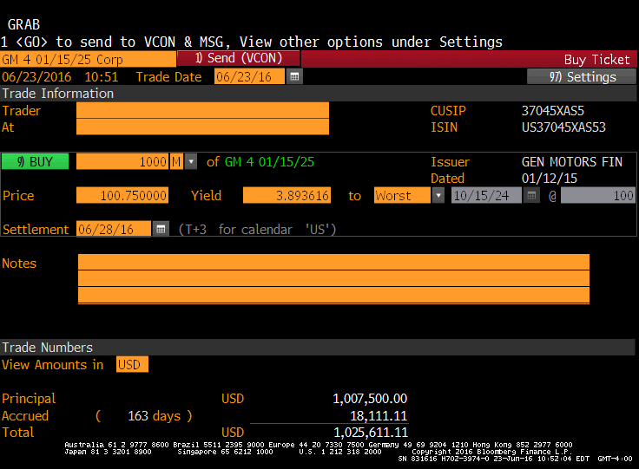

Slide 15
The Trade Lifecycle
Pre-Execution
Execution
Matching & Confirmation
Post Booking
Settlement

Slide 16
Trade Life Cycle Overview: Matching and Confirmation
Trade Execution
Trade Capture (Front and Back Office)
Trade Enrichment
Trade Validation
Trade Agreement
Trade Settlement
Pre Value Date Settlement Instruction Status
The Role of the Custodian
Settlement Instructions
Transaction Reporting
Pre-Execution

Slide 17
Trade Matching
Exchange-traded deals:
Buyers and sellers automatically matched within clearing systems
Each counterparty sends their OTC trade tickets to the other counterparty’s back office:
Back office looks for discrepancies between the two versions of the trade ticket
The process is increasingly automated (electronic)
Mistakes are corrected
Material differences may result in legal intervention
Does not affect legal status of the trade
Trade Enrichment

Slide 18
Trade Agreement/Matching
Trade agreement is when the counterparty confirms the trade (trade affirmation) or when a trade is matched.
Trade Affirmation – Where one party executes the trade details and the counterparty is sent the trade details from a trade affirmation facility. The counterparty can then agree or disagree to the trade.
Trade Matching – Where two parties execute the trade details and the trade matching facility returns settlement instructions to the counter party
Trade Validation

Slide 19
The Trade Lifecycle
Pre-Execution
Execution
Matching & Confirmation
Post Booking
Settlement

Slide 20
Trade Life Cycle Overview: Post Booking
Trade Execution
Trade Capture (Front and Back Office)
Trade Enrichment
Trade Validation
Trade Agreement
Trade Settlement
Pre Value Date Settlement Instruction Status
The Role of the Custodian
Settlement Instructions
Transaction Reporting
Pre-Execution

Slide 21
Post Booking Tasks
Take place after the matching & confirmation process but before settlement:
Payment of fees (Broker fees etc.)
Managing Settlement Instructions (SI’s)
Trade Matching
Reporting of errors
Cash flows
Monitoring:
P&L (Profit & Loss)
VaR (Value at Risk)
NAV (Net Asset Value)
Settlement
Trade Validation

Slide 22

Instruction Content
Settlement Instructions:
Traded instrument
Price
Net Settlement Amount
Receiving Counterparty
Counter- Broker Handling Transaction
Account to be credited
Settlement date
Counter Party’s Broker
Buyer’s Broker
Match
DTCC
Settlement Instructions
Settlement Instructions
Trade Instrument 1
Trade Instrument 2
Trade Agreement

Slide 23
Overnight Processes
Information from trades is aggregated each night to produce a series of reports by trade, portfolio and asset class:
Profit & loss
Absolute (total to date)
Incremental (Daily, weekly, monthly)
VaR (Value at Risk)
Net Asset Value (NAV)
Risk
Trading activity
Collateral requirements
Cash flow requirements for settlement
Transaction Reporting

Slide 24
The Trade Lifecycle
Pre-Execution
Execution
Matching & Confirmation
Post Booking
Settlement

Slide 25
Trade Life Cycle Overview Settlement
Trade Execution
Trade Capture (Front and Back Office)
Trade Enrichment
Trade Validation
Trade Agreement
Trade Settlement
Pre Value Date Settlement Instruction Status
The Role of the Custodian
Settlement Instructions
Transaction Reporting
Pre-Execution

Slide 26
Types of Settlement
Physical settlement – commodities
Cash settlement
Holder doesn’t exercise an option
Settlement Instructions

Slide 27
Settlement Terms
Settlement is the process when parties exchange goods and cash.
Value Date – day when value is set for a fluctuating asset
Contractual Settlement Date – date when payment is processed, but product doesn’t have to received on same day
Actual Settlement – trade is completed when seller receives payment and buyer attains asset
Settlement Date - day when transaction of asset/cash is done.
Settlement Concerns
Confirm seller has financial products at respective custodians
Guarantee buyer has appropriate cash for payment.
Can be through funding, multiple balance payment accounts
Can be through credit with the custodian (or other parties)
Can be through a collateral agreement to offset the funds.
The Role of the Custodian

Slide 28
Inventory Management
Managing assets to be sold.
Inventory Management ensures:
There is adequate stock of product
Products are at location need to be
Products are deliverable on requested date
Pre Value Date Settlement Instruction Status

Slide 29
Netting
Two counterparties add up profit & loss from all trades with each other.
A single payment settles all of the trades.
Must be agreed in advance by the two parties.
Example:
HSBC + 1000 Barclays – 1000
HSBC – 500 Barclays + 500
HSBC – 400 Barclays + 400
HSBC – 200 Barclays + 200
HSBC + 200 Barclays – 200
+ 100 - 100
Trade Settlement

Slide 30
Questions
What is a master agreement?
Explain what netting means?
What is the 1st stage and last stage of the trade lifecycle?
In what stage do the overnight processes take place?
What is a trade ticket and in what stage would a trade ticket be produced?
What is the stage before post booking?

